Slide 1
AARJ AGM 2023

Slide 2
Some key 2023 initiatives
Nationally advertising any new restorative positions
Updates for members on: reports, academic literature, media, presentations
Restorative practices modules developed for NSW Education Department
Foundational Text: Setting Relations Right in Restorative Practice
Communities of practice: facilitators
Emerging clinical practice guidelines / templates
AIC: Evaluation of the ACT Phase 3 Restorative Program
Other communities of practice: administrators, researchers/evaluators, workplace
New Redress Schemes: Stolen Generations, Elite Sports
Plans for November 2024 CANBERRA Conference: Contemporary Restorative Practice
Emerging links with other international Associations:
The Centre for Restoration (India); Korea Association for Restorative Justice; United Kingdom Restorative Justice Council and Mint House… More to come…

Slide 3
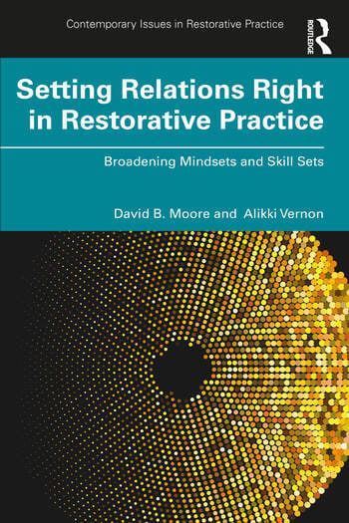

Slide 5
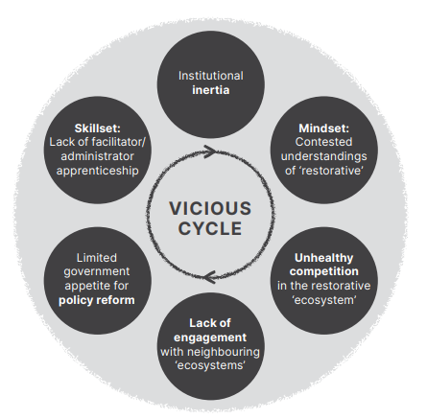
A vicious cycle has blocked restorative reform
*
(Moore & Vernon 2024)

Slide 6
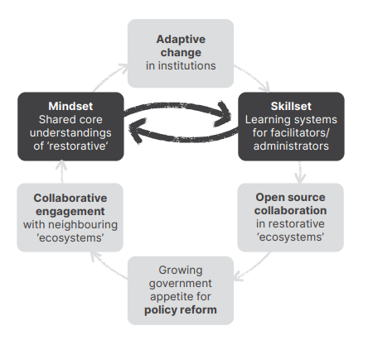
A virtuous cycle can drive restorative reform
(Moore & Vernon 2024)

Slide 7
A community of restorative practice can support a group of:
facilitators
to develop a complex understanding of how restorative processes work, & increase their skills to facilitate restorative processes in diverse contexts
policy-makers
to authorise, augment and fund restorative programs
administrators
to implement and operate those programs
researchers / evaluators
to review outcomes that a restorative process delivers for participants, & a restorative program delivers for a larger cohort

Slide 8
Innovations in practical theory
Distinguishing program administration from process facilitation
Identifying common principles of facilitation across different programs
Developing a system for reflective practice while learning facilitation
within one program
Extending that learning system:
to different programs across a region
to different cases within a program
across different jurisdictions

Slide 9
Restorative practice requires both:
ADMINISTRATION
following guidelines to ensure
standard
specific actions
in every case
FACILITATION
following
general principles
to guide the
requisite variation to
set relations right
in each case

Slide 10
Restorative justice
Responding to harm with healing

Slide 11
Restorative practices
Managing
community relations
with processes
& techniques
that help to
build,
maintain,
deepen,
& repair relations

Slide 12
Restorative engagement
within
Redress Schemes
that link
individual recovery
with
institutional reform

Slide 13
Redress Schemes offering restorative engagement
Restorative practices
Restorative justice
Facilitated
processes

Slide 14
Foundational Restorative Principles
Do no further harm
Work with people
(rather than doing to or doing for them)
Set relations right
(& thus support healing)

Slide 15
Setting relationships right between people may mean a relationship:
is “restored”
[to something positive]; or
is deepened;
is “neutralised”
[and so no longer involves intense conflict]; or
is formally ended
[and so effectively non-existent]; or
is established
[between participants meeting for the first time]
(Moore & Vernon 2024)

Slide 16
conflict
disputation
⬄ being in two minds ⬄
⬄ not agreeing to disagree ⬄
forming factions ⬄
people ⬄ system friction ⬄
system ⬄ system friction ⬄
David Moore & Alikki Vernon Setting Relations Right in Restorative Practice Routledge 2024

Slide 17
VARIATIONS on the Group Conference Format
A single incident of undisputed harm | A sequence of poorly resolved incidents | An issue of common concern | A legacy of betrayal trauma
What happened and how were people affected? What now needs to be done to: repair harm, reduce the risk of further harm, & restore right relations? | Things were good (enough) [1] Things turned bad [2] Things went from bad to worse [3] Now something really needs to be done | We have different specific experiences of the same general situation: [1] Specific examples [2] General Issues [prioritised] [3] General Options [4] Specific Action | An historic abusive situation that has caused trauma: [1] A narrative of the incident or patterned behaviour [2] Official response [3] Shared lessons [4] Plans for further action & ongoing support

Slide 18
Skills for effective facilitation
DIAGNOSING
What type of situation is this?
DEFINING
What process(es) will help us deal with it?
PREPARING
What does each participant need to recount, ask, discuss?
QUESTIONING
What have the people involved experienced?
NEGOTIATING
How can the people involved improve their circumstances?
REFLECTING
What are people doing well, & should keep doing – perhaps do even more?
David Moore & Alikki Vernon Setting Relations Right Routledge 2024

Slide 19
Restorative practices
Managing
community relations
with processes
& techniques
that help to
build,
maintain,
deepen,
& repair relations

Slide 20
Rationale   Level | Reacting | Preventing | Promoting
One way | coaching mentoring
Two-way | Structured conversations
Mediation | Assisted negotiations
Facilitation | Group meetings

Slide 21
The basic learning cycle
Facilitators, administrators, and evaluators
participate in the same foundational training
Practitioners build expertise incrementally:
less-experienced team members observe more experienced colleagues ‘on-the-job’
Learning-on-the-job commences with facilitating in less complex cases,
ideally working alongside a colleague, and working towards competence:
not only to facilitate in more complex cases,
but also to support less-experienced colleagues to learn-on-the-job
Structured debriefing supports facilitators to reflect after an intervention
A standard format for case studies supports collective reflective practice
Lessons from reflective practice helping to review and fine-tune
facilitator guidelines and the program framework

Slide 22
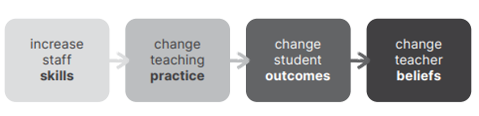
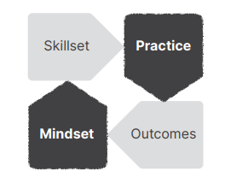
Skills development starts the cycle
Guskey 1986; Moore & Vernon 2024

Slide 23
Reflective practice templates guide conversations between:
a less-experienced- and more-experienced facilitator –
about specific techniques
two experienced facilitators –
about the general strategy of an intervention
a facilitator at any level of experience and
their line manager, an evaluator, or a policy-maker –
to articulate the practical theory

Slide 24
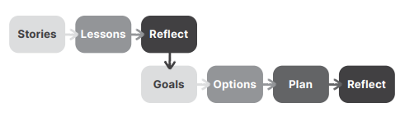
Collective reflective practice
(Moore & Vernon 2024)

Slide 25
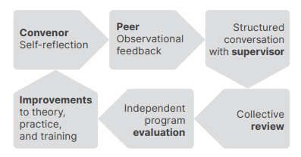
Individual and collective reflective practice
(Moore & Vernon 2024)

Slide 26
Reformers need to:
DIAGNOSE
existing programs and processes
FINE-TUNE
program administration & process facilitation –
so that good practice can become standard practice
ALIGN practice
to encourage consistency across programs
(Moore & Vernon 2024)

Slide 27
The “Goldilocks principle”: “just right” for reform
POPULATION SIZE
Large enough for a range of services and small enough for good working relations between professionals
DISTANCE
Far enough from central authorities to provide some autonomy, but not so far as to be disconnected
DIVERSITY OF EXPERIENCE
Colleagues learn skills from each other,
especially practitioners from other services observing-in-action the facilitation skills of YJGC colleagues
LEVEL OF EXPERIENCE
most professionals find some of their expertise transferable
AMBITION
An initial modest goal to use restorative processes consistently in schools, youth justice and/or child protection,
Then extending to restorative practice in health, community law, community-controlled organisations, and consultancies
COMMITMENT
At least one agency funds a position primarily to coordinate restorative practices,
making it far easier to direct the commitment of other coalition members towards sustainable reform
Robinson, Katina & Sandra Hamilton, with Bernie Binns, Marg Kent, David Moore & Bonnie Renou (2015)
‘Restorative practice evolving through community networks: Lessons from the Central Victorian Restorative Justice Alliance’
New Community Journal vol. 13 Issue 50

Slide 28
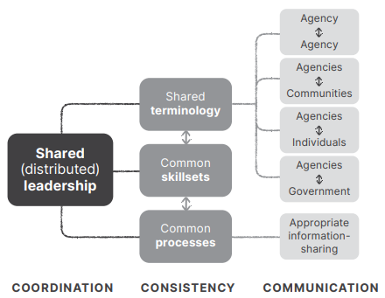
Distributing leadership
(Moore & Vernon 2024)

Slide 29
Implementing restorative practices
Restorative practices can be understood as a system for improving systems:
less about implementing a new program
more a continuous exercise in reviewing, fine-tuning, & aligning practice
We distinguish:
principles, from programs, from processes
administrative processes from facilitated processes
A system for improving systems requires a system for learning-on-the-job
Learning requires reflecting on how we apply general principles
Some unit / group needs to coordinate this learning system
(Moore & Vernon 2024)

Slide 30
The Association Committee
Association Office Bearers
President: David M, Vice President/Secretary: Alikki V, Treasurer: David V
Institutional Representatives
Key Restorative Justice programs: Gen Higgins, ACT RJ Unit staff
Key areas of practice:
Education: Kristy Elliott, First Nations Organisations: Aunty Lois Peeler,
Faith Organisations: Michael Wood
State & Territory Representatives
Queensland: Christine Jones, ACT: Amanda O’Neill, ; Tasmania: Rikki Mawad
South Australia: Amanda Lutz, Western Australia: Graham Castledine
+ Administrator

